Slide 1
Quality Management System Deliverable Software 9115 revision A Key changes presentation
IAQG 9115 Team
August 2019

Slide 2
9100D / 9115 revision A
Table of contents
Background
Reasons for the 9115 revision
High Level Structure
Key Changes
Questions

Slide 3
9115 revision A
Background

Slide 4
9100D / 9115 revision A
Background
Reminder: AS9115 supercedes AS9006, which was published in March, 2003 as an Americas only standard
Later Internationally adopted as 9115
AS9115 - Software Supplement to AS9100
Adds specificity and granularity for compliance with the objectives of AS9100 requirements for Deliverable Software
Deliverable Software
Developed or modified, airborne, shipborne, space borne or ground software
Can be a stand alone deliverable software by contract line item or embedded in deliverable product
Unmodified COTS components excluded

Slide 5
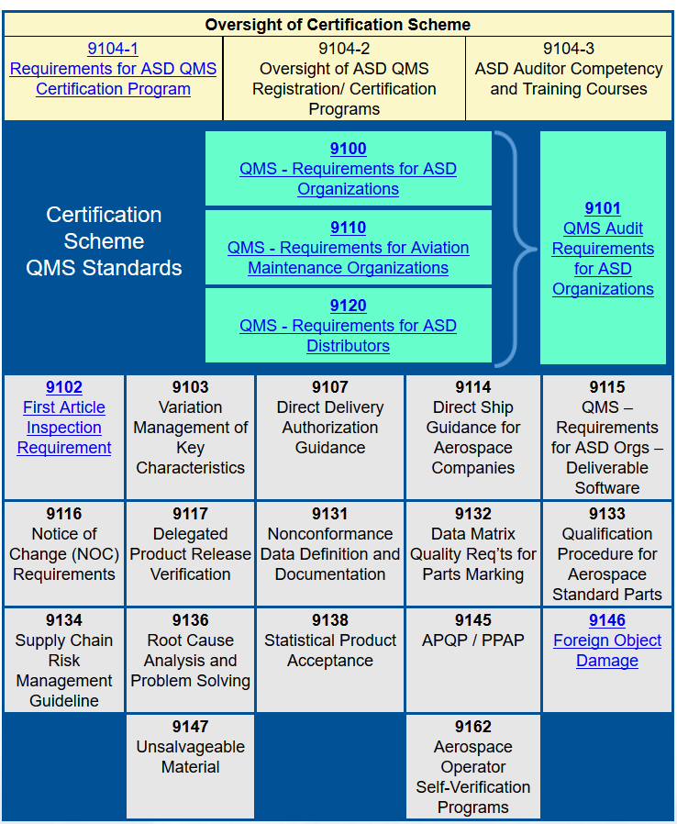
9100D / 9115 revision A
AS9115 SUPPLEMENTS AS9100
Clarifies 9100 requirements relative to deliverable software
http://www.sae.org/iaqg/organization/requirements.htm

Slide 6
AS9100 Reference to AS9115
AS9100 Section titled “Intended Application” references AS9115:
NOTE: Organizations whose products are deliverable software, or contain deliverable software, should use the IAQG-developed 9115 standard (see Bibliography) when planning and evaluating the software design, development, or management activities of the organization. The 9115 standard provides guidance to the requirements of the 9100 standard when it is desired to add “software” to the 9100 quality management system scope.

Slide 7
9100D / 9115 revision A
Example of standard AS9115 verbiage when AS9100 text applies with NO clarification needed for deliverable software
AS9115

Slide 8
9100D / 9115 revision A
Example of standard AS9115 verbiage when AS9100 text applies WITH clarification needed for deliverable software
AS9115

Slide 9
9115 revision A
Reasons for revision

Slide 10
9100D / 9115 revision A ISO 9001 / 9100 core reasons for change
Adapt to a changing world
Enhance an organization's ability to satisfy its customers
Provide a consistent foundation for the future
Reflect the increasingly complex environments in which organizations operate
Ensure the new standard reflects the needs of all interested parties
Integrate with other management systems

Slide 11
9100D / 9115 revision A The “9100” needs to change, to:
Incorporate changes made by ISO TC176 to the ISO 9001:2015 requirements (ISO liaison organized to collaborate with the IAQG 9100 team and to obtain consideration for IAQG requirements)
Consider Aviation, Space and Defense stakeholders’ needs identified since the last revision (web survey performed in 2013)
Consider clarifications to 9100 series requests issued by IAQG since the last revision (requirements clarified or notes added)

Slide 12
9100D / 9115 revision A Why “9115” needed to change:
AS9100 changed to align with ISO 9001:2015
Respond to changes in software development methods
Consider threat profiles to Aviation, Space and Defense software systems – adds themes of cybersecurity
Advances in tools, simulations and testing capabilities
Recognize the expanded scales of software impact such as cloud based services, mobile apps, small embedded web based servers and networked appliances
Ensure mitigation of potential quality concerns are met for software
Disposition the collection of feedback related to 9115 since 2010

Slide 13
9100 revision D / 9115 revision A
High Level Structure

Slide 14
9100 revision D High Level Structure (from ISO 9001)
High Level Structure
ISO is going from 8 clauses to 10 clauses
Rationale
Better alignment to business strategic direction
With PDCA approach
More compatible with other management system standards
Implementation Considerations
Review your current QMS structure (preferable to adapt the QMS structure to the Business Processes)
Plan
Do
Check
Act
4
Context of organization
5
Leadership
6
Planning
7
Support
8
Operation
9
Performance Evaluation
10
Improvement

Slide 15
Plan
Do
Check
Act
4
Context of organization
5
Leadership
6
Planning
7
Support
8
Operation
9
Performance Evaluation
10
Improvement
9100 revision D
High Level Structure
(from ISO 9001)
4.1
Understanding context
6.1
Actions to address risk and opportunity
7.1
Resources
8.1
Operational planning and control
9.1
Monitoring, measurement, analysis and evaluation
10.1
General
5.1
Leadership and commitment (MS)
4.2
Interested parties
7.2
Competence
10.2 Nonconformity and corrective action
5.2
Policy
8.2
Determination of requirements for products & services
6.2
Objectives and planning
7.3
Awareness
9.1.2
Customer satisfaction
4.3
Scope
5.3
Organizational roles, responsibilities and authorities
8.3
Design and Development of products & services
10.3
Continual improvement
6.3
Planning of changes
7.4
Communication
9.1.3
Analysis and evaluation
4.4
Processes
7.5
Documented information
8.4
Control of externally provided processes, products & services
9.2
Internal audit
9.3
Management review
8.5
Production and service provision
8.6
Release of products & services
8.7
Control of nonconforming outputs

Slide 16
9115 revision A
Key Changes

Slide 17
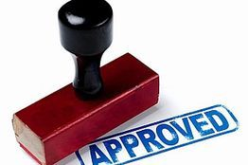
9115 revision A High quality software is not enough
In the past, software had to meet functional and safety requirements
This alone is no longer adequate
Now, software and it’s environment must also be SECURE – Information Assurance

Slide 18
9115 revision A Understanding: Information Assurance, Information Security and Cybersecurity
Information Assurance as defined in AS9115:
“The set of activities needed to protect information and information systems by ensuring availability, integrity, authentication, confidentiality, and non-repudiation including protection, detection, and reaction capabilities.
This includes activities conducted to reduce vulnerability of operational networks, Information Technology (IT), and computing equipment. Activities may include development of innovative and cost-effective ways to mitigate those vulnerabilities. IA may include actions to provide assured access, and transparent identification and authentication across the network or within systems of systems.”
Source: IAQG International Dictionary
Notes:
“Information Assurance” is defined in the IAQG Dictionary located at: https://www.sae.org/iaqg/dictionary/

Slide 19
9115 revision A
Significant addition to 9115 standard:
Enhanced cybersecurity requirements

Slide 20
9115 revision A Cybersecurity derived themes
Culture of Security
Technical Security
Software Life Cycle Security
Supply Chain Security
Internal Audit of Cyber Security
Notification, Response, and Recovery
NIST Cybersecurity Framework (NIST 800-53)

Slide 21
9115 revision A
1.0 – Scope: provides inclusion of mobile applications, and services (e.g. cloud environment, web hosted solutions or platforms)
3.0 – Terms and Definitions:
Information Assurance – new definition
Interested Parties – replaces Stakeholder
Non-developmental Software – added Government off-the Shelf (GOTS) software to definition
Software Life Cycle – slight definition revision to provide clarity
Support Software – slight definition revision to provide clarity
Validation – slight definition revision to provide clarity
Verification – slight definition revision to provide clarity

Slide 22
9115 revision A Note: this is the most impactful IA requirement added
4.0 – Context of the Organization:
Requirement for Organizations to include the appropriate Information Assurance elements when determining the scope of the organization’s QMS.
See the IAQG Supply Chain Management Handbook (SCMH) for further information.

Slide 23
9115 revision A
6.0 – Planning:
Adds software services to the list of considerations for Risk Management
This should include external providers, when appropriate
7.0 – Support:
7.1.3 and 7.1.4: Focuses on information assurance considerations in infrastructure
7.2: Ensures competence appropriate for the criticality and complexity to support customer and system requirements
7.5.3: Requires resource retention to access legacy data

Slide 24
9115 revision A
8.0 – Operation:
Software planning addresses software related activities from project planning through product delivery and maintenance
Quality objectives and requirements expressed in measurable terms, including critical items and key characteristics
Defined rules, practices, conventions, techniques, and methodologies for development and test
Strong software configuration management guidance
Focus on product integrity and safety
Prevention of counterfeit software (8.1.4)

Slide 25
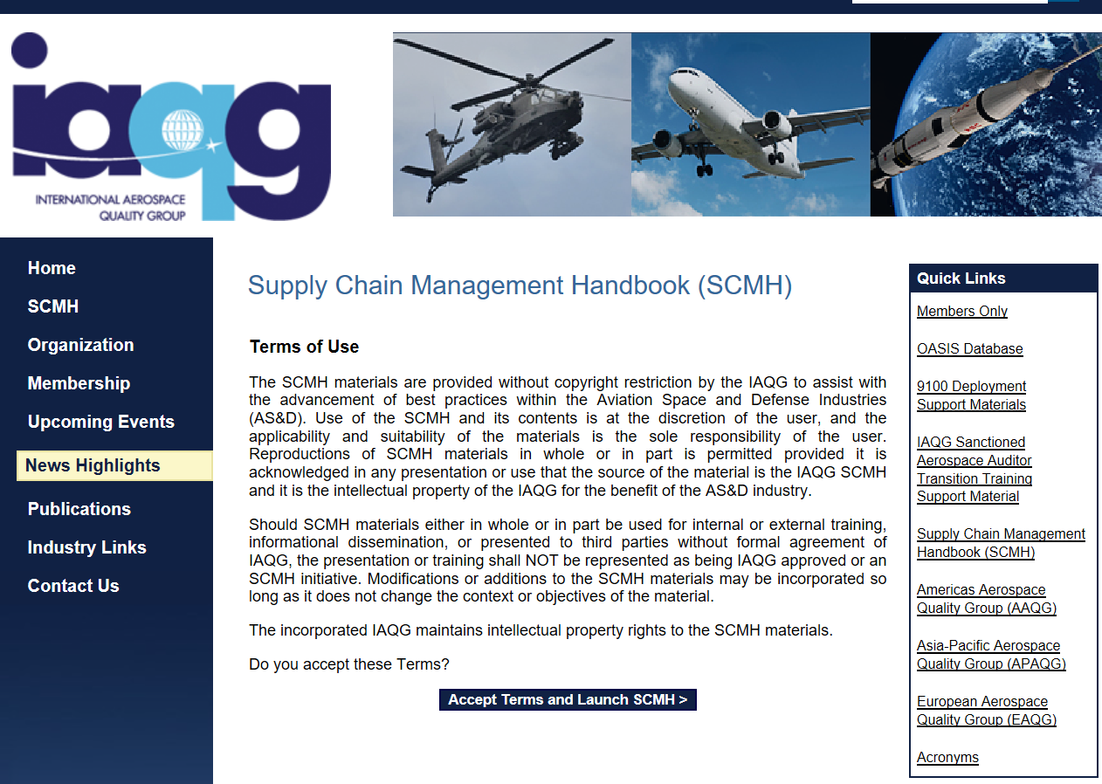
9115 revision A
9.0 – Performance Evaluation:
Software organizations analyze and evaluate industry data on emerging threats and vulnerabilities
Internal audits include software aspects of the QMS
Support materials on 9115 and software QMS:
IAQG Supply Chain Management Handbook

Slide 26
Questions?
IAQG
Raymond Wright – IDR
raymond_wright@raytheon.com
AAQG
Inez Gronewold – SDR
inez.gronewold@collins.com
APAQG
Satoshi Kikuchi – APAQG SDR
kikuchi-satoshi@axis-corp.co.jp
EAQG
Hartwig Flory – EAQG SDR
hartwig.flory@airbus.com

Slide 28
Revision History
Date | Author | Description
Aug 30, 2019 | Gronewold, Inez | Updated slides to 2019 format, added revision history slide, corrected Satoshi’s email on slide 26.

